Slide 1
Underwater Wireless
Communication
Presented By
Nikhilesh Shinde
Shyam Kumar Sahu
PCCOE

Slide 2
Summary
Background &Introduction
UW Architectures and UWSN
Applications
Research challenges
Advantages and Disadvantages
Future Expansions
Notes:
Only general

Slide 3
Background
In Early 1990 underwater communication
systems involve SONAR Technology
for Submarine & Obstacle detection.
Underwater wired media for oil & Gas
stations Monitoring.

Slide 4
Why Underwater Wireless networks ?
Wired media does not provides guaranteed
transmission of information.
Much slower speed of acoustic propagation
in water, about 1500 m/s.
Conventional Sound Waves does not work
well in an Shallow underwater environment.

Slide 5
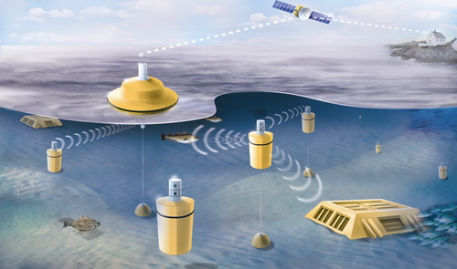
INTRODUCTION

Slide 6
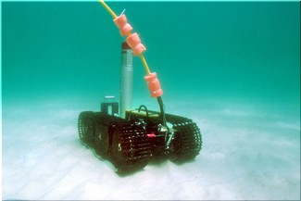
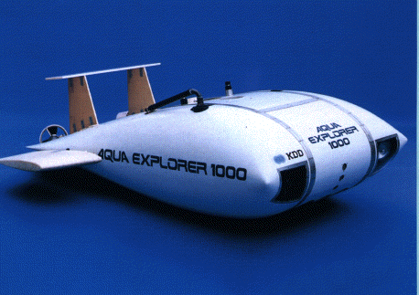
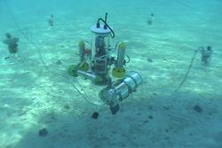
INTRODUCTION
Group of sensors and vehicles deployed
underwater and networked via acoustic
links, performing collaborative tasks
Equipment
  Autonomous Underwater Vehicles (AUVs)
  Underwater sensors (UW-ASN)

Slide 7
UW Architectures and UWSN
Two-dimensional Underwater Sensor
Networks : for ocean bottom monitoring
Three-dimensional Underwater Sensor
Networks : for ocean-column monitoring
Sensor Networks with Autonomous UW
vehicles : for underwater explorations

Slide 8
Communication Technologies
Optical Communication
  IEEE 802.15.4 Based on a VHDL
  LED blue light impulses as Transmitter
  & Photodiode as a Reciever
EM (Electromagnetic ) waves for short range Swarms of Senesor nodes.

Slide 9
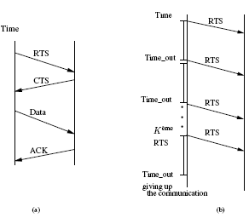
    MAC LAYER
    Adapted MACA to underwater acoustic networks
      It uses CTS-RTS-DATA exchange and for Error detection STOP and WAIT ARQ
      Retransmitting packets because of timeout in receiving ACK
      The source drops the communication after K trials

Slide 10
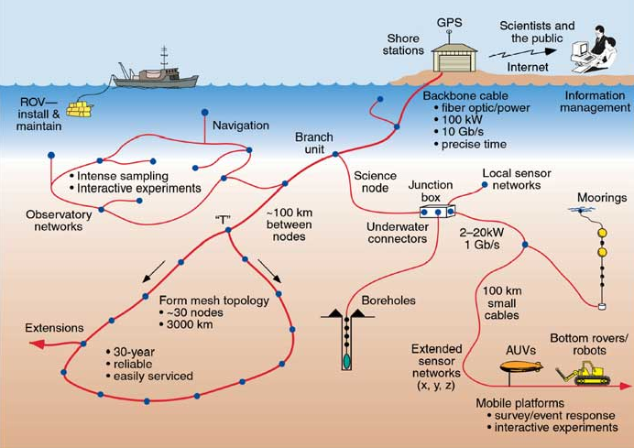
NETWORK LAYER

Slide 11
Network Layer
Proactive routing protocols
Reactive routing protocols
Geographical routing protocols
TONE-Lohi Protocol

Slide 12
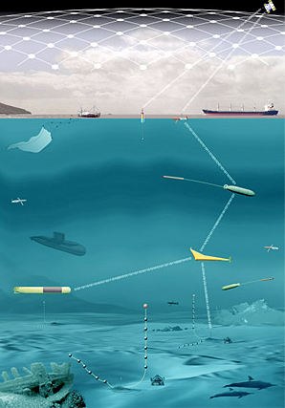
TRANSPORT LAYER

Slide 13
TRANSPORT LAYER
A transport layer for UW-ASNs requires:
  Reliability hop by hop
  In case of congestion, transport layer
  need to be adapted faster to
  decrease the response time
  Minimum energy consumption to avoid many
  feedbacks with the ACK mechanism that
  can utilize bandwidth unnecessarily

Slide 14
Research Challenges
  Security & Robustness.
  Traffic Congestion Control.
  Efficient Multiple Access.
  To increase the Limited Battery Power
  To reduce the High delay
    Propagation delay Underwater=5 x Radio Frequency(RF)ground

Slide 15
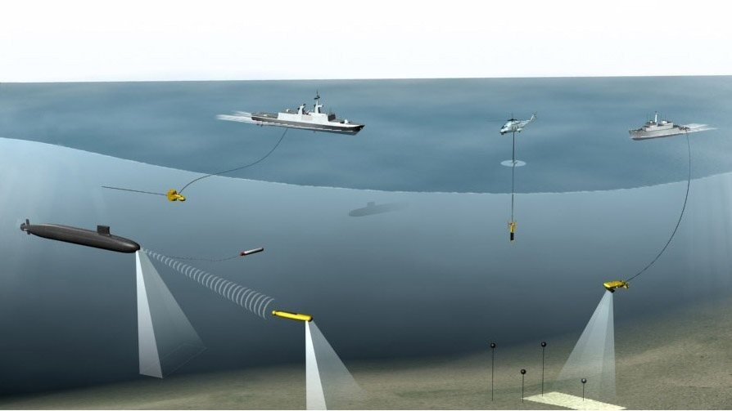
Applications
  Environment monitoring
  Undersea explorations
  Disaster prevention
  Assisted navigation
  Application to oil-field monitoring

Slide 16
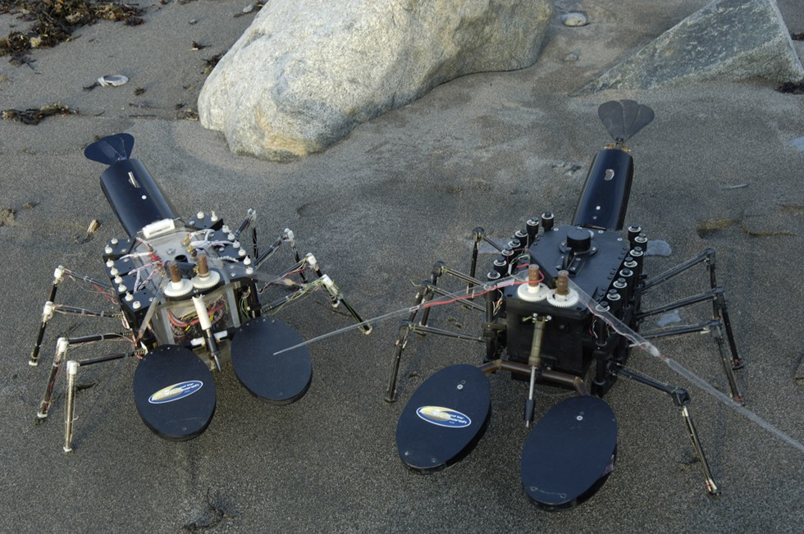
Underwater Remote Sensors

Slide 17
Advantages
Real time Underwater security.
Quick alert monitoring in Between UW-AV
in oil field and gas station.
It can project better for marine researches,
naval systems & submarine for accurate
communication between them

Slide 18
Disadvantages
    UWSNs are expensive
    Power require for UWSNs is higher
    Tendency of failure in the underwater
    sensors because of corrosion

Slide 19
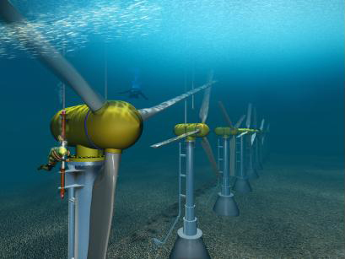
Future Expansions
In future information can be
transmitted digitally over a
wireless network..
A point-to-point optical
communication system, using
laser-emitting diodes (LEDs).

Slide 20
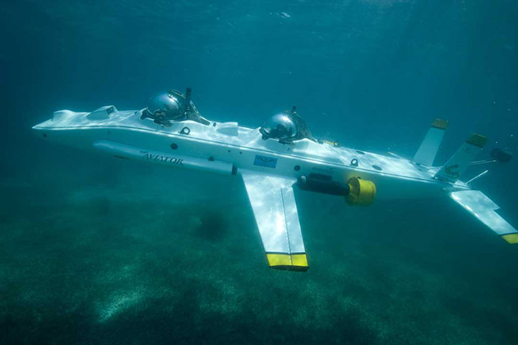
Future Expansions Cont.
Telesonar is an emerging technology for
wireless digital communications .
Seatooth an High speed Data transmission
technology .

Slide 21
Conclusions
Acoustic waves will be staying as
the major carrier of wireless communication
in UWSNs.
Losses can be avoided for long
distance by collaboration of terrestrial
networks and UWSNs.

Slide 22
References
[1] Under Water Sensor Networks at BWN Laboratory,
Georgia Institute of Technology, Available from
<http://www.ece.gatech.edu/research/labs/bwn/UWASN/>.
[2] Ocean Engineering at Florida Atlantic University,
Available From
<http://www.oe.fau.edu/research/ams.html/>.

Slide 23

Thank you!
Any Questions

